Slide 1
User Acceptance and best practices

Slide 2




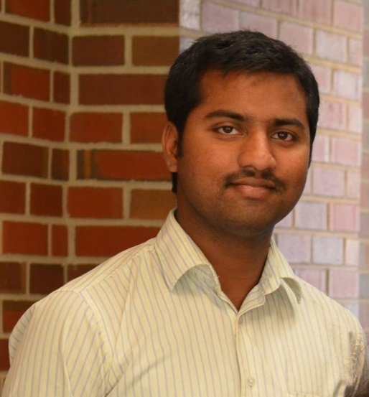
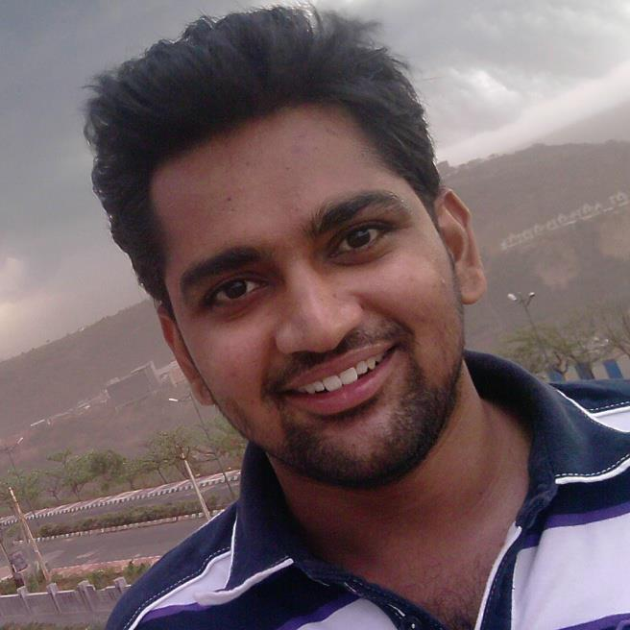
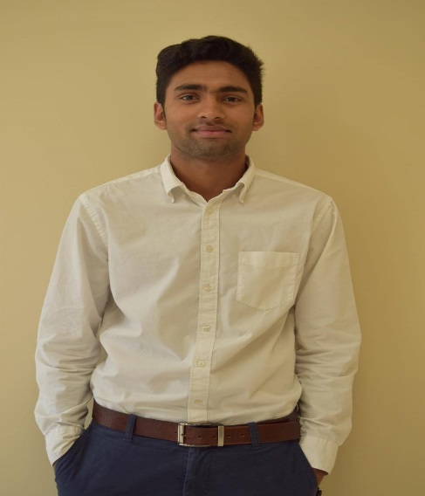

Team members
Bhanu Teja Kurucheti
Vinod Kumar Kurma
Nikhil Yerram
Nikhil Akula
Manoj Kumare Are
Maruthi Prasad Rao Chava
Prahasith Akkiraju
Sanjeev Koneru

Slide 3
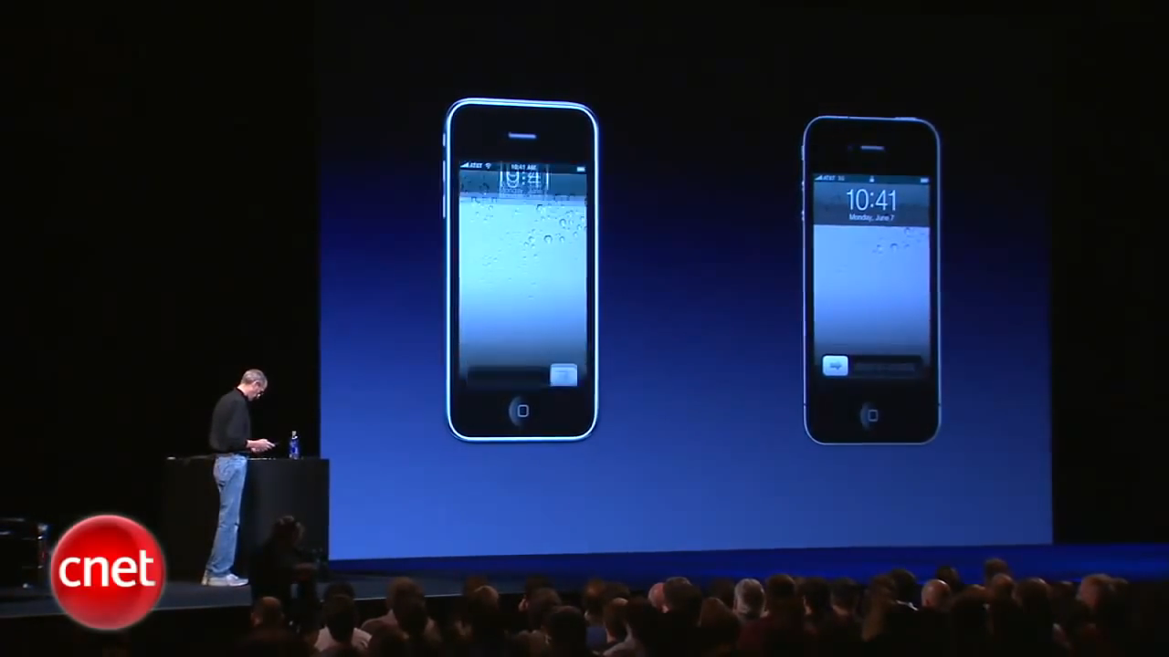
A small video about UAT
Bhanu Teja Kurucheti

Slide 4
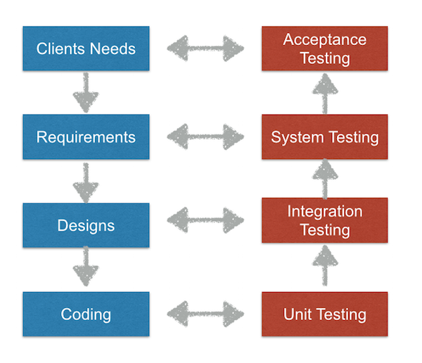
What is UAT?
Bhanu Teja Kurucheti
Notes:
http://usersnap.com/blog/types-user-acceptance-tests-frameworks/

Slide 5
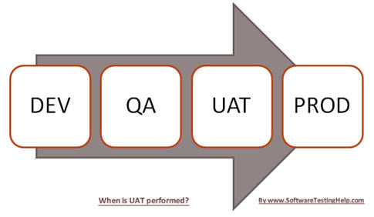
When is UAT performed?
Bhanu Teja Kurucheti
Notes:
http://www.softwaretestinghelp.com/what-is-user-acceptance-testing-uat/

Slide 6
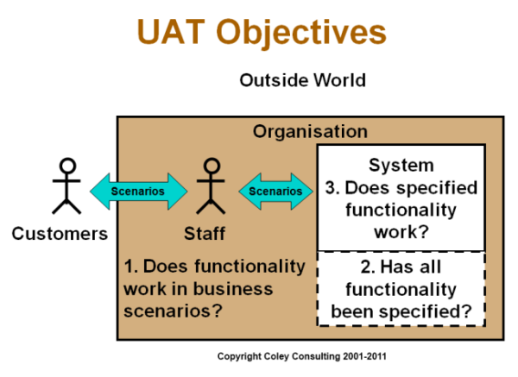
Bhanu Teja Kurucheti
Notes:
http://www.coleyconsulting.co.uk/UAT_Objectives.htm

Slide 7
Types of User Acceptance Testing
Alpha & Beta Testing
Contract Acceptance Testing
Regulation Acceptance Testing
Operational Acceptance Testing
Black Box Testing
Bhanu Teja Kurucheti
Notes:
http://usersnap.com/blog/types-user-acceptance-tests-frameworks/

Slide 8
UAT Project example demo
Bhanu Teja Kurucheti

Slide 9
Develop a comprehensive UAT Desk Aide
Identify people, process, technologies and timelines.
It should outline key processes.
It drives productivity.
Having “Top 10 Execution Guidelines” for the project.
Performance Testing
Vinod Kumar Kurma

Slide 10
Discussing testing approaches with UAT team
Wide variation of software testing knowledge across the team.
Mix of individuals with different testing methodologies.
Plan open discussion with the team.
Vinod Kumar Kurma

Slide 11

Bridge the gap between test management tools
Developers and QA personnel don’t agree on one testing tool.
Bridge the gap by building custom interfaces.
Understand the implications of each interface.
Vinod Kumar Kurma

Slide 12
Measuring Testing Expertise
Establish a framework to initially measure testers expertise
Document every UAT tester’s functional and technical ability.
A tester with lot of experience may not be effective in testing the modernized IT system.
Vinod Kumar Kurma

Slide 13
Communication and Coordination
Communication is the lifeblood of successful projects.
Formal communication should never take the place of intangible aspects of communication
Vinod Kumar Kurma

Slide 14
Best Practices to Reach Client Expectations
Outline What You’ll Cover:
Use plain English
Usage of bullet points
Outline What You Won’t Cover:
Along with the what you’ll cover, outline what you won’t be covering.
- Nikhil Kumar Akula

Slide 15
Best Practices to Reach Client Expectations
Ask More Questions:
Client may not always verbalize his expectations, like implicit expectations which is holds without telling you.
Ask more and more questions.
- Nikhil Kumar Akula
Notes:
You have to ask more and more questions like “What technology we have to use?”, “What is the preferred time and way of communication?”, “Is there any specific style or color client wants us to use?” etc.

Slide 16
Best Practices to Reach Client Expectations
Use Client’s Preferred Communication Method:
Always ask the client how he wanted to communicate.
Always offer the options that you’re comfortable with yourself.
Follow Up In Writing:
Following up with an email on what you have just discussed in the meeting.
It is a very tedious process but it is absolutely necessary.
- Nikhil Kumar Akula
Notes:
Use Client’s Preferred Communication Method:
Always ask the client how he wanted to communicate, it makes him feel important, valued and validated and shows that you care.
But always offer the options that you’re comfortable with yourself.
Follow Up In Writing:
Following up with an email on what you have just discussed in the meeting will give you a chance to reiterate and show your understanding.

Slide 17
Best Practices to Reach Client Expectations
Get In Touch More Often:
Send an email and schedule meetings with the client.
It helps the client to know about the progress of the project and give a Feedback.
Don’t Hide The Unpleasant Stuff:
Let the client know if you’re running late on the delivery dates, or have any technical issues etc.
- Nikhil Kumar Akula
Notes:
Get In Touch More Often:
Don’t wait for the client to contact instead send an email and schedule meetings with the client from time to time.
It helps the client to know about the progress of the project and give a Feedback and it will also make him feel important.
Don’t Hide The Unpleasant Stuff:
Don’t be afraid to let the client know if you’re running late on the delivery dates, or have any technical issues etc.

Slide 18
Best Practices to Reach Client Expectations
Don’t Start Until The Terms Have Been Agreed Upon And Signed:
Under no circumstances project should be started until both the parties have signed the scope.
This scope document will act as an insurance policy in the long way if there’s a misunderstanding or worse.
- Nikhil Kumar Akula

Slide 19
Representing Acceptance Criteria
Acceptance Criteria are a set of statements, each with a clear pass/fail result.
Specify both functional and non functional requirements.
These requirements represent “conditions of satisfaction.”
Expressed clearly without ambiguity.
They must be testable.
Manoj Kumar Are
Notes:
Acceptance Criteria must be expressed clearly, in simple language the customer would use, just like the User Story, without ambiguity as to what the expected outcome is: what is acceptable and what is not acceptable. They must be testable: easily translated into one or more manual/automated test cases. There is no partial acceptance: either a criterion is met or it is not.

Slide 20
Representing Acceptance Criteria (contd..)
Acceptance Criteria should include:
1. Functional Criteria
2. Non-Functional Criteria
3. Performance Criteria.
Manoj Kumar Are
Notes:
Acceptance Criteria should include:
1. Functional Criteria: Identify specific user tasks, functions or business processes that must be in place. A functional criterion might be “A user is able to access a list of available reports.”
2. Non-Functional Criteria: Identify specific non-functional conditions the implementation must meet, such as design elements. A non-functional criterion might be “Edit buttons and Workflow buttons comply with the Site Button Design.”
3. Performance Criteria:If specific performance is critical to the acceptance of a user story, it should be included. This is often measured as a response time, and should be spelled out as a threshold.

Slide 21
Examples
1. Functional Criteria: User is able to view the list of fraternities
2. Non-Functional Criteria: Navigation Links at top left
3.Performance Criteria: Response time
Manoj Kumar Are
Notes:
If user submit request, Host user should assign a Guard to that request with in the response time and alert message will be displayed.

Slide 22
When to define Acceptance Criteria
Writing acceptance criteria after development has started.
Verify the Functionality
Acceptance criteria before implementation begins
Capture the customer intent rather than the development reality.
Manoj Kumar Are
Notes:
This leads to merely verifying that the functionality built works rather than verifying that the functionality meets user needs and expectations. If we write and review the criteria before implementation begins, we’re more likely to capture the customer intent rather than the development reality.

Slide 23
Format to specify the criteria
Given/When/ Then format is helpful
Given some precondition. When I do some action. Then I expect some result.
It provides a consistent structure.
It helps testers determine when to begin and end testing.
Manoj Kumar Are

Slide 24
Example User Story
As a Basic user I want to see the list of available fraternities. so that I will select the available fraternity whenever problem occurs in the party I attended
Manoj Kumar Are

Slide 25
Example Acceptance criteria
The list of fraternities are displayed based on the university registered by the user.
The fraternities not related to the user location are not visible.
User can claim request by selecting a fraternity near to him/her.
The host user will assign a guard to the request.
Manoj Kumar Are

Slide 26
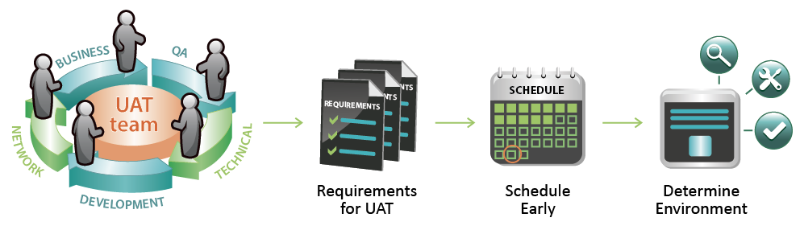
Managing UAT
Maruthi Chava

Slide 27
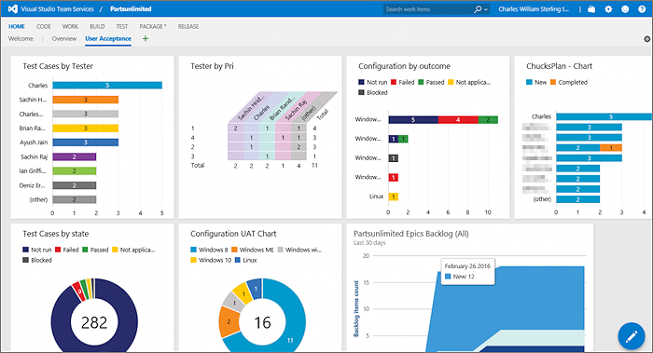
Managing UAT
1. Get the right tools for the job
The tools should meet the requirements in the 5 key areas
workflow configuration
custom fields
easy to use filters
clear reporting/dashboards
access control
Maruthi Chava

Slide 28
Managing UAT
Co-ordination and Communication with client
The supplier make sure the customer knows what is ready for testing.
The client make sure the supplier aware of the expected delivery dates.
Recommended to open channels
Customer Project Manager to Supplier Project Manager.
Customer Tester to Supplier Tester.
Maruthi Chava

Slide 29
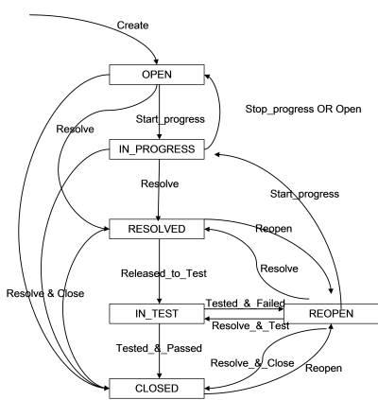
Managing UAT
The Right Defect Tracking Process
Open
In Progress
Resolved
In Test
Reopened
Closed
Maruthi Chava

Slide 30
Managing UAT
Getting Communication Right with Distributed Teams
Telephone, chat, video conferencing and desktop sharing.
Contractors
Different companies
Different operating
Maruthi Chava

Slide 31
Managing UAT
Release Notes
Are you tracking your defects effectively?
Bug fixes before the product is delivered for UAT.
The customer has some confidence on the process.
It confirms the implementation/fixing
Maruthi Chava

Slide 32
Managing UAT
To Share or Not to Share?
Depends on sensitivity of data and project
This project is available to both supplier and customer.
Integrate customer and supplier with their own defect tracking tools.
On all the issues pertinent to the UAT project.
Maruthi Chava

Slide 33
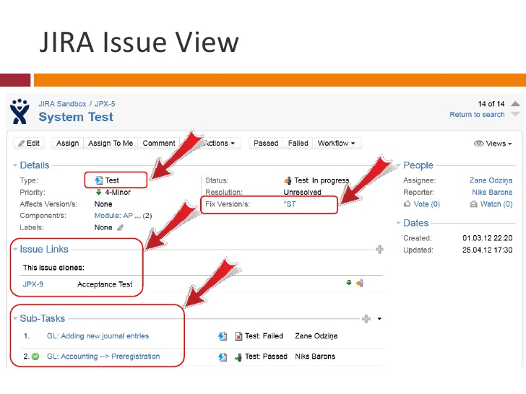
Managing UAT
Training On Using The Tools
Use the right tool for the job.
Implement on right data sets.
Training prevents time waste.
Maruthi Chava

Slide 34

Managing UAT
Regular Short and Sharp Defect Review Meetings
Its good to have daily defect review meeting. These meetings need to be short, sharp.
quick summary
check priority and allocation
short clarification if necessary
Maruthi Chava

Slide 35
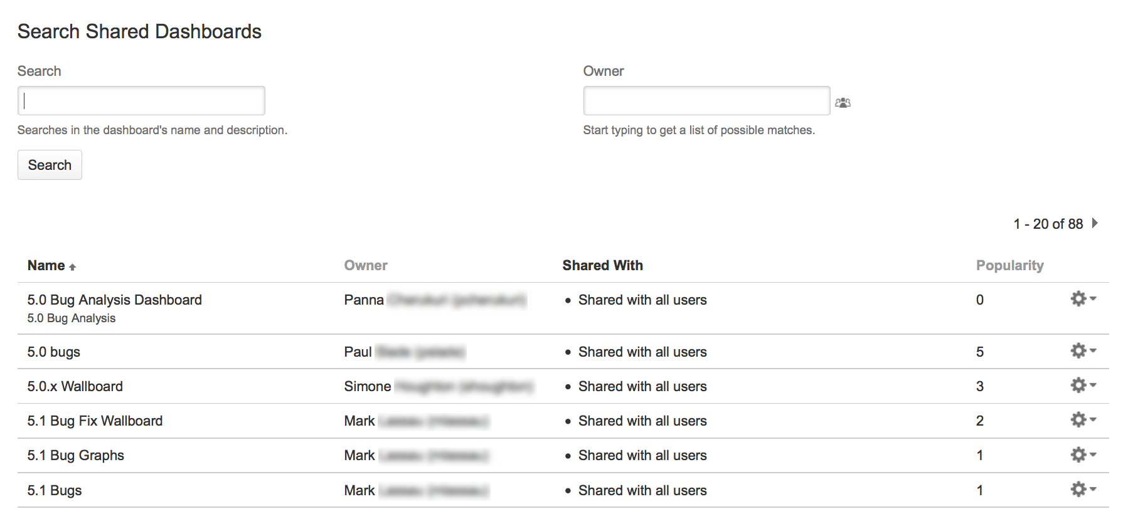
Managing UAT
Configure Shared Dashboards and Filters Right at the Start
Tracking effort
Make decisions
Take action
Balancing load
Maruthi Chava

Slide 36
Managing UAT
Daily Status Reports
Key points
Test Coverage
Top Priority Defects
Test Blockers
Defect Stats
Maruthi Chava

Slide 37
Managing UAT
People:
If people work together to deliver, they find a way to succeed.
The best thing you can do is find two people
One from client side
One from supplier side
They work through the defect lists together and agree what's going into each release.
Maruthi Chava

Slide 38
Column Headings (UAM)
Requirement serial number
Description
Expected Behavior
Result
Severity
Comments
Prahasith Akkiraju

Slide 39
User Traceability Matrix
# Requirement No. | Description | Expected Behavior | Result | Severity | Comments
1 | Login in with the Facebook account credentials | It would show the home screen or will save the itinerary. | Pass | Medium
2 | Edit the itinerary | It will the change the time and dates accordingly | Fail | High | The times are not changing and they are synchronized properly.
3 | Setting your currency | It display the rates according your currency | Pass | Low
Fig : User Traceability Matrix
Prahasith Akkiraju

Slide 40
Version History
Version No. | Date | Changed By | Changes Made
1 | 9/1/2016 | Prahasith Akkiraju | Initial Commit
2 | 9/15/2016 | Suprem Manthena | Added the itinerary map features vaguely build
3 | 10/1/2016 | Abbu Srilatha | Added the login functionality with Facebook API
Prahasith Akkiraju

Slide 41
Test Cases Review and Approval
To be done before testing starts
Prepared By/Date: | Reviewed By/Date: | Approved By/Date:
Person name on 10/01/2016 | Suprem Raju Manthena on 10/02/2015
Person name on 9/26/2016 | Prahasith Akkiraju on 09/27/2015
Person name on 9/18/2016 | Suprem Raju Manthena on 09/19/2015
Prahasith Akkiraju

Slide 42
Test Runs
To be filled during testing
Run Number: | 1 | 2 | 3
Conducted by: | Krishna Painuly | Ashish Pandey | Ashish Pandey
Date: | 09/15/2015 | 09/15/2015 | 09/15/2015
Run Number: | 1 | 2 | 3
Conducted by: | Ashish Pandey | Krishna Painuly | Krishna Painuly
Date: | 10/01/2016 | 10/01/2016 | 10/01/2016
Prahasith Akkiraju

Slide 43
Defect Data Consolidation
To be filled after completion of testing
Defect # | Tester | Description | Date Reported | User Level Tested | Severity (H/M/L) | Date Reported to Contractor | Status (Open or Fixed)
1 | Ashish | Login Functionality | 10/1/2016 |  | H
2 | Krishna | Selecting the Currency | 10/2/2016 |  | L
Prahasith Akkiraju

Slide 44
Test Review and Approval
All Test Cases have been executed (Y/N) | Y
All defects have been closed (Y/N) | Y
Any other comments: No
Testing Reviewed By/Date: | 10/02/2016 | Testing Approved By/Date: | --
Prahasith Akkiraju

Slide 45
User Acceptance Criteria Matrix
Usually done at the end of project
If the user and the client agree on the product, the application development is done
Identify problems which unit or integration tests might have missed
Sanjeev Koneru

Slide 46




Working Example
End Users
Sigma Phi Epsilon
Bash Guardians
(Development Team)
Client
Phi Delta Theta

Slide 47
User Acceptance Criteria Matrix
As we are following agile methodology
We need to deliver the working software at the end of every sprint
In two sprints, we demonstrated our app user interfaces to our client.
First sprint – Client Demo1 (09/16)
Second sprint – Client Demo2 (09/30)
Sanjeev Koneru
Notes:
So far

Slide 48
First Sprint (Client Demo1)
S.No | Task | Expected Comments | Actual Comments | No. of changes
1 | Login page with appropriate credentials | Excellent | Remove the fb and twitter login | 2
2 | New user registration | Excellent | No comments | 0
3 | View Home page-Fraternity houses list | Excellent | Populate based on location (most nearer) | 1
4 | Display Menu | Excellent | Location change can be updatable | 1
5 | Select the Incident | Excellent | No comments | 0
6 | Select the location of incident | Excellent | No comments | 0
Table1: User Acceptance Testing Matrix-1
Sanjeev Koneru

Slide 49
Second Sprint (Client Demo2)
S.No | Task | Expected Comments | Actual Comments | No. of changes
1 | Login page with appropriate credentials | Excellent | When guard user logs in he shouldn’t see PG team tab | 1
2 | Available guard users | Excellent | Guard users should be populated based on availability | 1
3 | Alerts tab | Excellent | Should have a timer for 15 mins | 1
4 | History | Excellent | No comment | 0
5 | Update profile | Excellent | No comment | 0
6 | Resolution messages | Excellent | Messages are sent by host user | 1
Table2: User Acceptance Testing Matrix-2
Sanjeev Koneru

Slide 50
Example Data
Week | Completed | Tasks To be completed
0 | 0 | 30
1 | 4 | 26
2 | 5 | 21
3 | 5 | 16+4=20
4 | 4+3 | 13
5 | 5 | 8+4=12
Sanjeev Koneru

Slide 51
Burndown chart
Sanjeev Koneru

Slide 52
Tools for User Acceptance Testing
Earlier User Acceptance Testing was done using spread sheets.
Feasible and easy to use tools for UAT.
Some of them are Usernap, QASymphony, engageuat etc.
engageuat – Risk mitigation, save time & cost, real- time reporting.
Nikhil Yerram.
Notes:
http://www.engageuat.com/dashboard – link to engageUAT tool

Slide 53


